Slide 1
Inventory Management System
A project by Doug Miller

Slide 2
Objective
The aim of this project is to demonstrate all the skills I have been taught over the first 5 weeks, culminating in the development of an inventory management system that demonstrate skills and understanding in
Agile & Project Management
Databases
Cloud Fundamentals
Programming Fundamentals
Continuous Integration
Automated Testing

Slide 3




Specification
The project required the end user be able to interact with the inventory management system via a Command Line Interface. The user must be able to add, view, update and delete both customers and items.
The user must be able to create an order and have the option to either add or delete an item from an order and be able to calculate the cost of an order.
Finally the user must also be able to update the quantity of an item within an order and view all orders within the system.
Add
View
Update
Delete

Slide 4
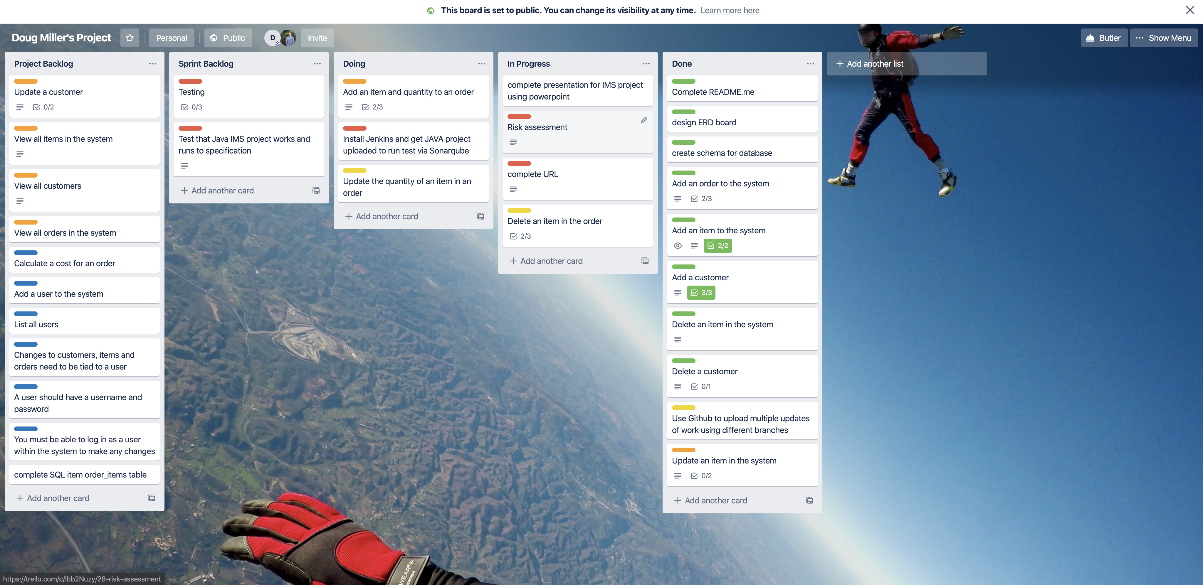
Analysis & Design
Adopting agile principles within this project was essential as I was learning new and complex skills each day that were ultimately essential to the completion of this project. In order to do this and keep track of the planning of the project I used a Kanban board via Trello which helped implement the concept of the Scrum principles. This helped keep track of tasks and help segregate each task as they became more relevant and therefore able to complete.
https://trello.com/b/bLKPQAeq/doug-millers-project

Slide 5
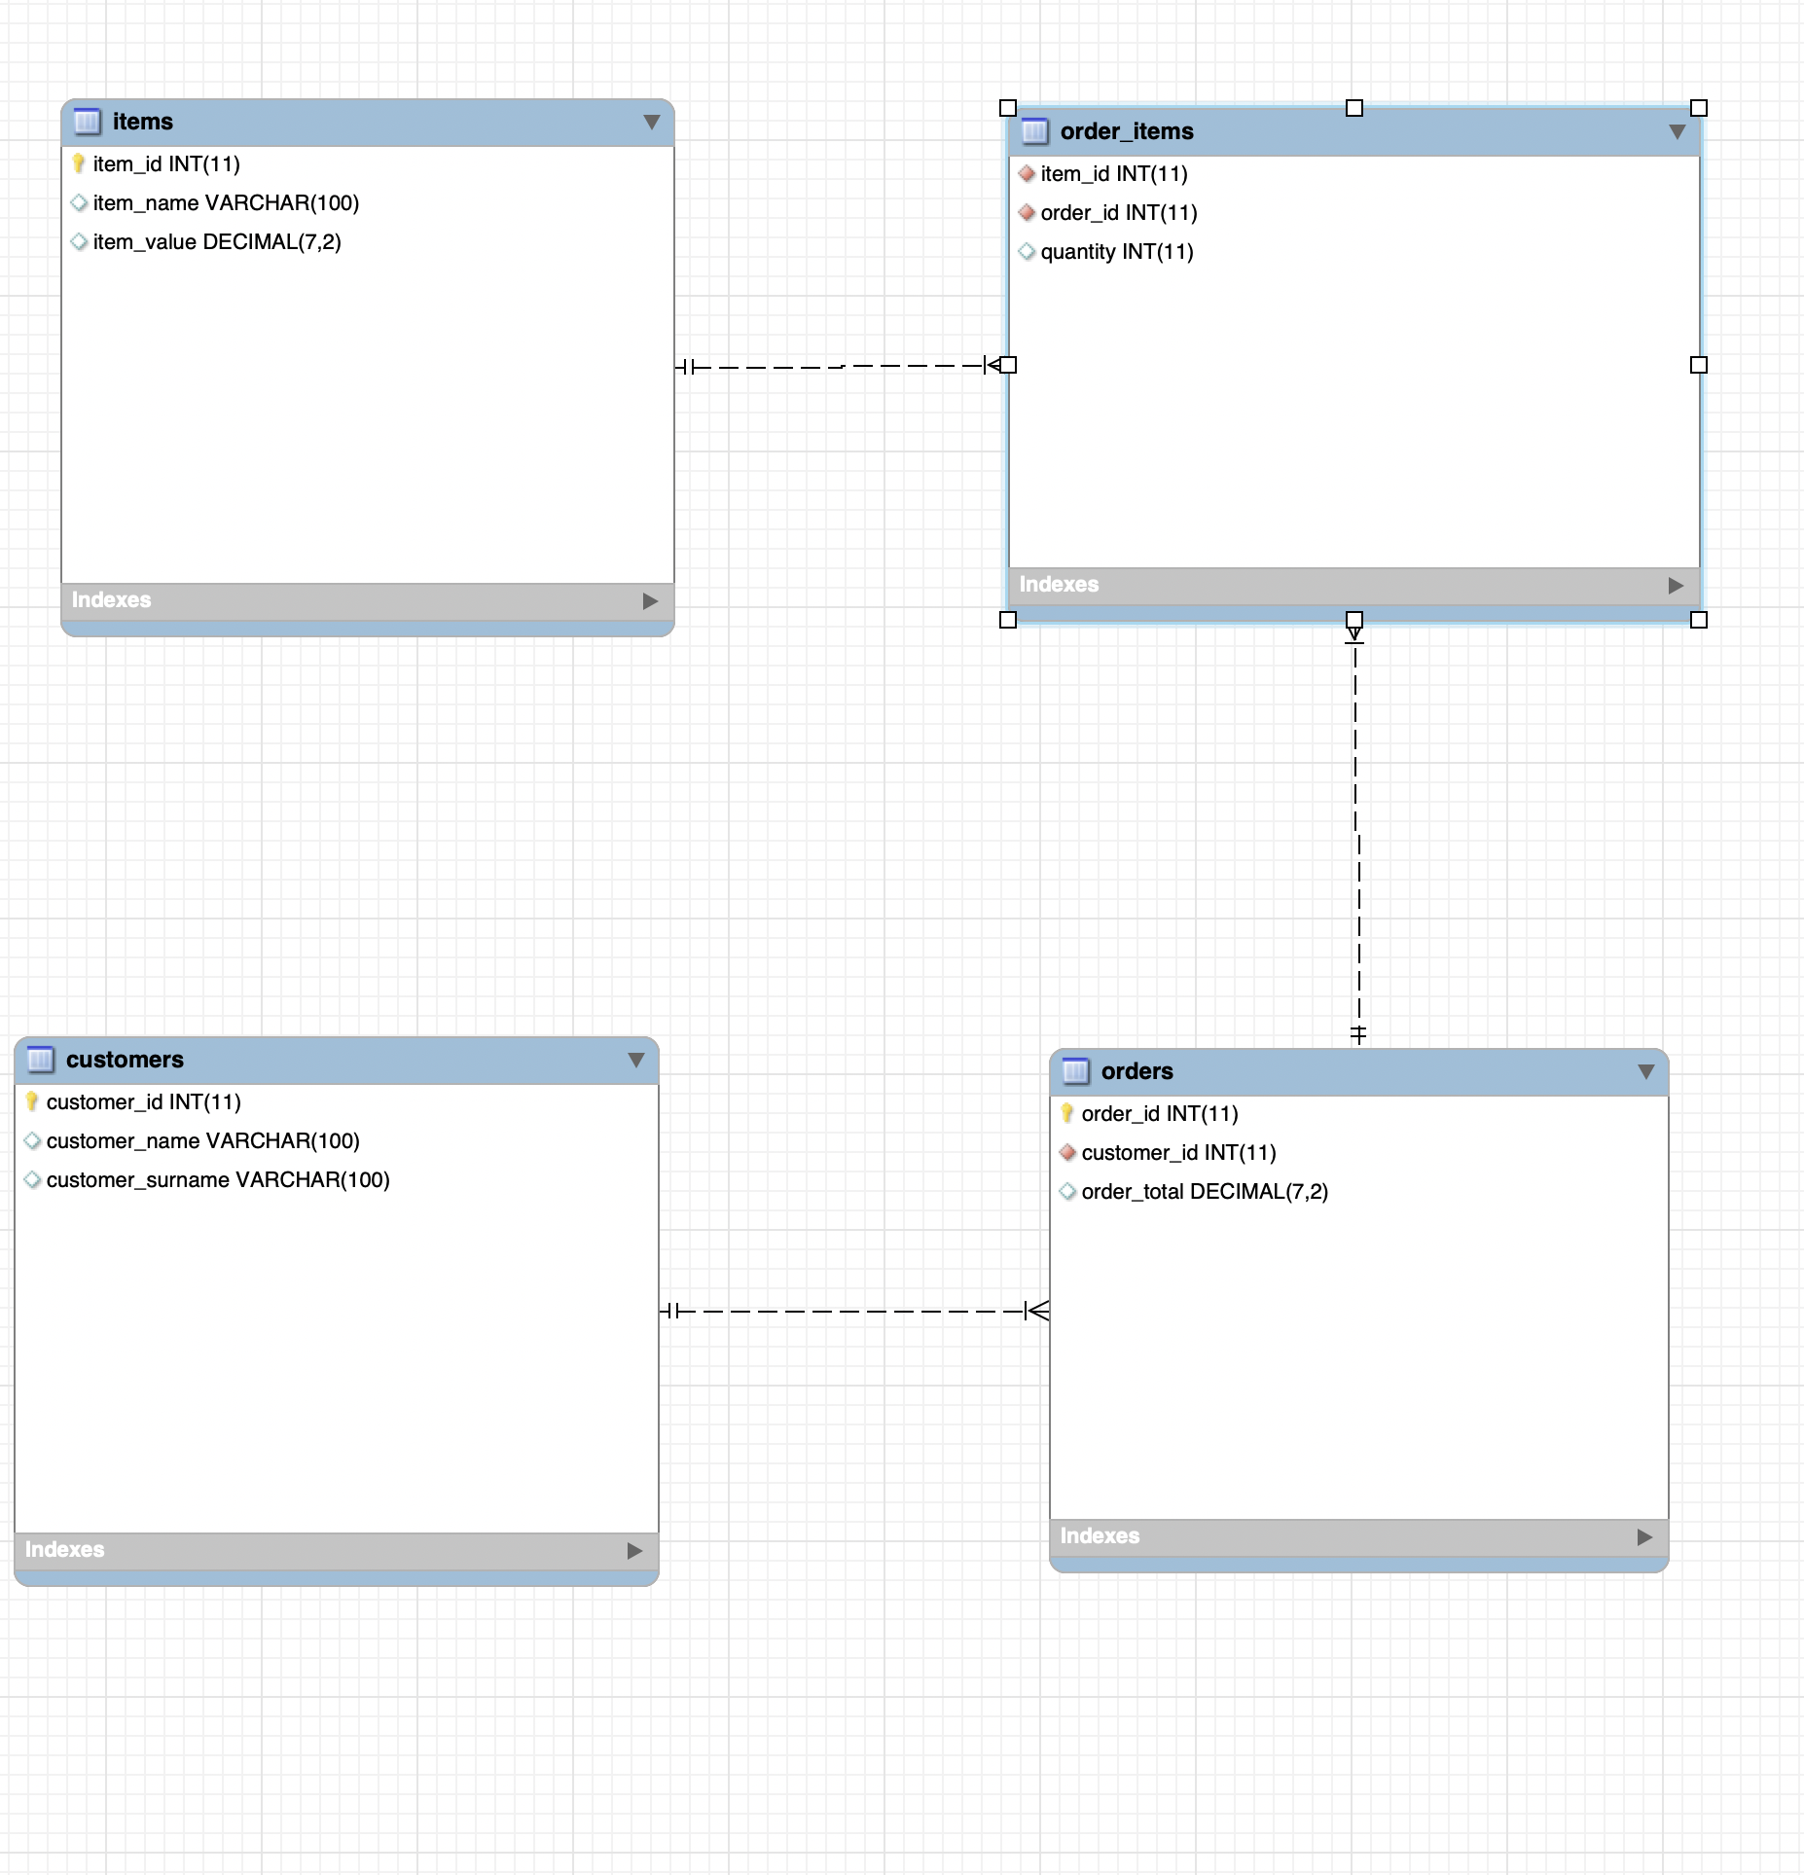
Analysis & Design
I used an Entity relationship diagram (ERD) to help visualize the relationship customer had with items and orders. An additional table was need to bridge the gap between orders and items as they had a many to many relationship . This meant I had to develop a join table (order_items) which allowed interaction between the two tables via an intermediary.

Slide 6
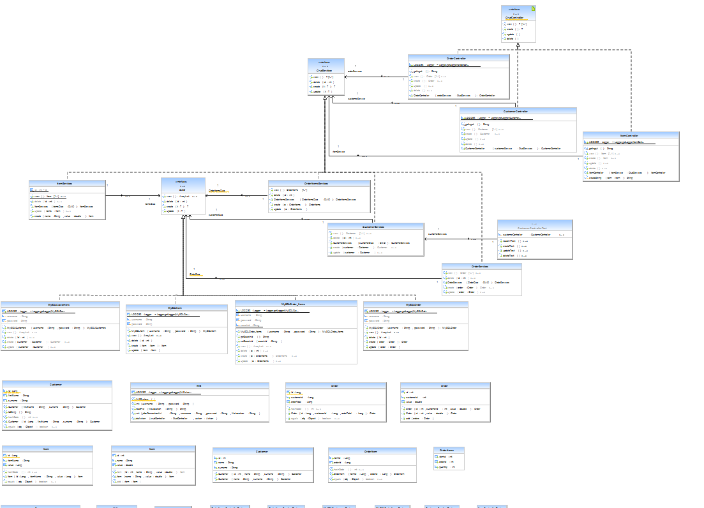
Analysis & Design
The Unified Modelling Language (UML) show the relationship and hierarchy of the packages and classes with the java IMS java project

